Slide 1
Importance of Indices
- Abburi Venkata Praveen

Slide 2
Project
Our project illustrates the role of indices to improve the Performance of database.
In evaluation plan, we demonstrate the difference of CPU cost, I/O cost, operator cost, no. of reads and logical reads between the queries with indices and without indices.

Slide 3


Two types of Indexes in SQL Server:
Clustered Indices
Non-clustered Indices
Creating a new Clustered Index
Creating a new Non-Clustered Index

Slide 4
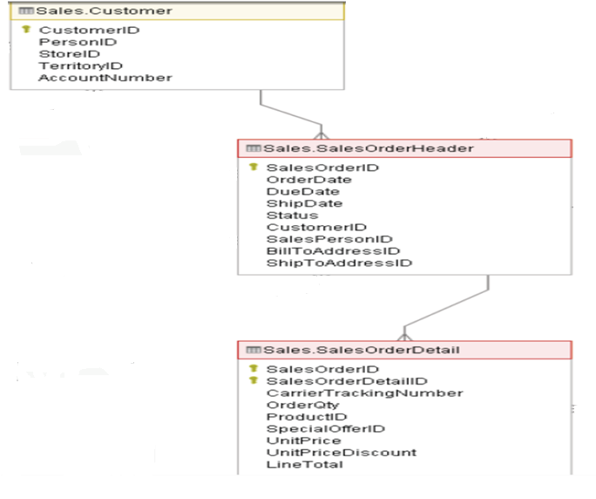
Data Set :

Slide 5
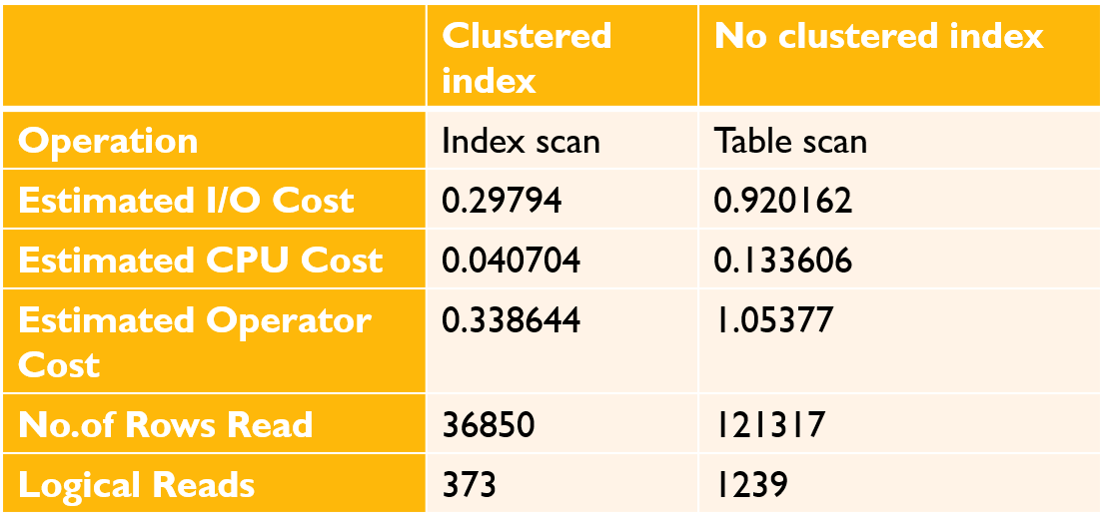
Clustered Index vs. No Clustered Index(1.1)
CREATE CLUSTERED INDEX IX_CLU_SOID ON Sales.salesOrderDetail (SalesOrderID);
select SalesOrderID,sum(UnitPrice) as total from Sales.SalesOrderDetail
where SalesOrderID>63559 and unitprice>100
GROUP BY SalesOrderID;

Slide 6
Clustered Index vs. No Clustered Index(1.2)
CREATE CLUSTERED INDEX IX_CLU_UP ON Sales.salesOrderDetail (UnitPrice);
select SalesOrderID,sum(UnitPrice) as total from Sales.SalesOrderDetail
where SalesOrderID>63559 and unitprice>100
GROUP BY SalesOrderID
 | Clustered index | No clustered index
Operation | Index scan | Table scan
Estimated I/O Cost | 0.4349 | 0.920162
Estimated CPU Cost | 0.0582 | 0.133606
Estimated Operator Cost | 0.4932 | 1.05377
No.of Rows Read | 52985 | 121317
Logical Reads | 625 | 1239

Slide 7
Clustered Index vs. No Index(2.1)
CREATE CLUSTERED INDEX IX_CLU_CIDON Sales.customer (CustomerID);
select customer.CustomerID,YEAR(OrderDate) Year, COUNT(YEAR(OrderDate)) Ordered from sales.Customer
INNER JOIN sales.SalesOrderHeader ON Customer.CustomerID=SalesOrderHeader.CustomerID
where customer.CustomerID between 29710 and 29720 and YEAR(OrderDate)=2012
GROUP BY YEAR(OrderDate),Customer.CustomerID
ORDER BY 3;
 | Clustered index | No clustered index
Operation | Index scan | Table scan
Estimated I/O Cost | 0.512917 | 0.60180
Estimated CPU Cost | 0.0349371 | 0.0567
Estimated Operator Cost | 0.54785 | 1.6585
No.of Rows Read | 31476 | 51285
Logical Reads | 687 | 806

Slide 8
Clustered Index vs. No Index(2.2)
CREATE CLUSTERED INDEX IX_CLU_CIDON Sales.salesOrderHeader (CustomerID);
select customer.CustomerID,YEAR(OrderDate),COUNT(YEAR(OrderDate)) Ordered from sales.Customer
INNER JOIN sales.SalesOrderHeader ON Customer.CustomerID=SalesOrderHeader.CustomerID
where customer.CustomerID between 29710 and 29720 and YEAR(OrderDate)=2012
GROUP BY YEAR(OrderDate),Customer.CustomerID
ORDER BY 3;
 | Clustered index | No clustered index
Operation | Index scan | Table scan
Estimated I/O Cost | 0.0958 | 0.60180
Estimated CPU Cost | 0.0222 | 0.0567
Estimated Operator Cost | 0.1180 | 1.6585
No.of Rows Read | 19904 | 51285
Logical Reads | 127 | 806

Slide 9
Clustered Index vs. No Index(2.3)
CREATE CLUSTERED INDEX IX_CLU_CIDON Sales.customer (CustomerID);
CREATE CLUSTERED INDEX IX_CLU_CIDON Sales.salesOrderHeader (CustomerID);
select customer.CustomerID,YEAR(OrderDate),COUNT(YEAR(OrderDate)) Ordered from sales.Customer
INNER JOIN sales.SalesOrderHeader ON Customer.CustomerID=SalesOrderHeader.CustomerID
where customer.CustomerID between 29710 and 29720 and YEAR(OrderDate)=2012
GROUP BY YEAR(OrderDate),Customer.CustomerID
ORDER BY 3;
 | Clustered index | No clustered index
Operation | Index scan | Table scan
Estimated I/O Cost | 0.00625 | 0.60180
Estimated CPU Cost | 0.000334 | 0.0567
Estimated Operator Cost | 0.01109 | 1.6585
No.of Rows Read | 95 | 51285
Logical Reads | 37 | 806

Slide 10
Non Clustered index vs. No Index(1.1)
CREATE NONCLUSTERED INDEX IX_NC_S_C_CID ON Sales.customer (CustomerId);
CREATE NONCLUSTERED INDEX IX_NC_S_SOH_SOI ON Sales.salesOrderHeader (salesOrderId);
CREATE NONCLUSTERED INDEX IX_NC_S_SOD_SOI ON Sales.SalesOrderDetail (salesOrderId);
SELECT sc.CustomerID,so.ProductID ,count(ProductID) as Purchased FROM Sales.Customer sc
INNER JOIN sales.SalesOrderHeader soh ON sc.CustomerID=soh.CustomerID
INNER JOIN sales.SalesOrderDetail so ON soh.SalesOrderID=so.SalesOrderID
Where sc.CustomerID between 29707 and 29725 and ProductID =726
GROUP BY sc.CustomerID,ProductID;
 | Non Clustered index | Without Non Clustered index
Operation | I Index scan, 2 Table scan | Table scan
Estimated I/O Cost | 1.4330 | 1.5219676
Estimated CPU Cost | 0.1685 | 0.1979645
Estimated Operator Cost | 1.6016 | 1.712303
No.of Rows Read | 152805 | 212242
Logical Reads | 1970 | 2287

Slide 11
Non Clustered index vs. No Index(1.2)
CREATE NONCLUSTERED INDEX IX_NC_S_C_SID ON Sales.customer (StoreID);
CREATE NONCLUSTERED INDEX IX_NC_S_SOH_CID ON Sales.salesOrderHeader (CustomerId);
CREATE NONCLUSTERED INDEX IX_NC_S_SOD_PID ON Sales.SalesOrderDetail (ProductID);
SELECT sc.CustomerID,so.ProductID ,count(ProductID) as Purchased FROM Sales.Customer sc
INNER JOIN sales.SalesOrderHeader soh ON sc.CustomerID=soh.CustomerID
INNER JOIN sales.SalesOrderDetail so ON soh.SalesOrderID=so.SalesOrderID
Where sc.CustomerID between 29707 and 29725 and ProductID =726
GROUP BY sc.CustomerID,ProductID;
 | Non Clustered index | Without Non Clustered index
Operation | 2 Index scan, 1 Table scan | Table scan
Estimated I/O Cost | 0.0982 | 1.5219676
Estimated CPU Cost | 0.0225 | 0.1979645
Estimated Operator Cost | 0.1238 | 1.712303
No.of Rows Read | 20256 | 212242
Logical Reads | 598 | 2287

Slide 12
Non Clustered index vs. No Index(1.3)
CREATE NONCLUSTERED INDEX IX_NC_S_C_CID ON Sales.customer (CustomerId);
CREATE NONCLUSTERED INDEX IX_NC_S_SOH_CID ON Sales.salesOrderHeader (CustomerId);
CREATE NONCLUSTERED INDEX IX_NC_S_SOD_PID ON Sales.SalesOrderDetail (ProductID);
SELECT sc.CustomerID,so.ProductID ,count(ProductID) as Purchased FROM Sales.Customer sc
INNER JOIN sales.SalesOrderHeader soh ON sc.CustomerID=soh.CustomerID
INNER JOIN sales.SalesOrderDetail so ON soh.SalesOrderID=so.SalesOrderID
Where sc.CustomerID between 29707 and 29725 and ProductID =726
GROUP BY sc.CustomerID,ProductID;
 | Non Clustered index | Without Non Clustered index
Operation | 3 Index scan | Table scan
Estimated I/O Cost | 0.0093 | 1.5219676
Estimated CPU Cost | 0.0009 | 0.1979645
Estimated Operator Cost | 0.0103 | 1.712303
No. of Rows Read | 459 | 212242
Logical Reads | 487 | 2287

Slide 13
Analysis of our Project
The number of rows read count with index table is less compared to the non index table.
In the clustered and non-clustered indices table I/O operator and CPU cost is less compared to the non indices table.
In clustered and non clustered scan is done at indices level where as in no indices scan is done at table level.
Logical reads are also low in indexed tables which can reduce the memory utilization while executing the queries, where as no index table has more logical reads.
By creating inds we can make queries more efficient by improving performance.

Slide 14


